Slide 1
Space & Time Complexity
Lecture - 2

Slide 2
Linear Time complexity

Slide 3
Single Loop Example
Public void xyz(int A[], int n)
{
For (Int i=0, i<n , i++)
{
A[i]=console.readline();
}
constant | repetitions | Total for O
1 +1 +1 | 1 + (n+1) + 1 | 1+(n+1)+n
1 + 1 | n + n | n+n
- | - | =1+n+1+n+n+n =4n+2 =0(n)
Neglect the constant terms .
Pick ‘n’ -> it can make changes if value can be any.
Most significant tern -> n
Growth of algorithm -> due to n

Slide 4
Nested Loop Example – different n , m
Code | Cost (time required for lines)units | Repetition (no of times executions) | total | Total(total time required in worest case)
Int sum (int[] A, int n) {
Int sum = 0,i, j; | 1 | 1 | 1 | 1
For (i=0; i<n ; i++) | 1+1+1 | 1+(n+1)+n | 2n+2 | 2n+2
{
for (j=1; j < m ; j++) | 1+1+1 | 1+m+(m-1) | (2m)n | 2mn
{ sum = sum+A[i]; | 2 | m – 1 | (2m - 2)n | 2mn-2n
}
Return sum; } | 1 | 1 | 1 | 1
 |  |  |  | 4mn+4

Slide 5
Quadratic Time Complexity

Slide 6
Nested Loop – dependent loop
code | Cost (time required for lines)units | Repetition (no of times executions) | total | Total(total time required in worst case)
Int sum (int[] A , int n)
{
int sum = 0 ; | 1 | 1 | 1 | 1
for (i=0; I < n; i++) { | 1+1+1 | 1+(n+1)+n | 2n+2 | 2n+2
for (j=0; j < n ; j++) | 1+1+1 | 1+n+(n-1) | (2n)n | 2n^2
{ sum = sum +A[i]; | 2 | n-1 | (2n-2)n | 2n^2 – 2n
}
Return sum; | 1 | 1 | 1 | 1
 |  |  |  | 4n^2 + 4 = 0(n^2)

Slide 7
Quadratic Example
For (i=1; i<n ; i++) 1+1+1 1+n+(n-1)
for (j=0; i<= n; j++) 1+1+1 1(n-1)+(n+1)(n-1)+(n-1)(n-1)
{
print 1 (n-1)(n-1)
}

Slide 8
Cubic Complexity

Slide 9
Cubic – 3 loop structure
Code | Cost (time required for lines)units | Repetition (no of times executions) | total
For(i=0; i<n; i++) | 1+1+1 | 1+(n+1)+n
for (j=1; j<n; j++) | 1+1+1 | 1+n+(n-1)
for(k=1; k<=n; k++) | 1+1+1 | 1+(n+1)+n
print() | 1 | 1
print() | 1 | 1
Calculate for cubic = ?

Slide 10
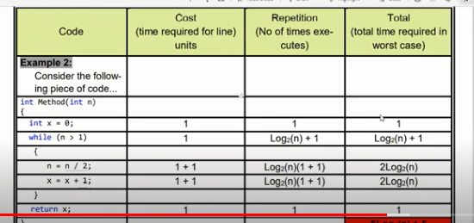
Logarithmic Complexity - i^2

